Slide 1
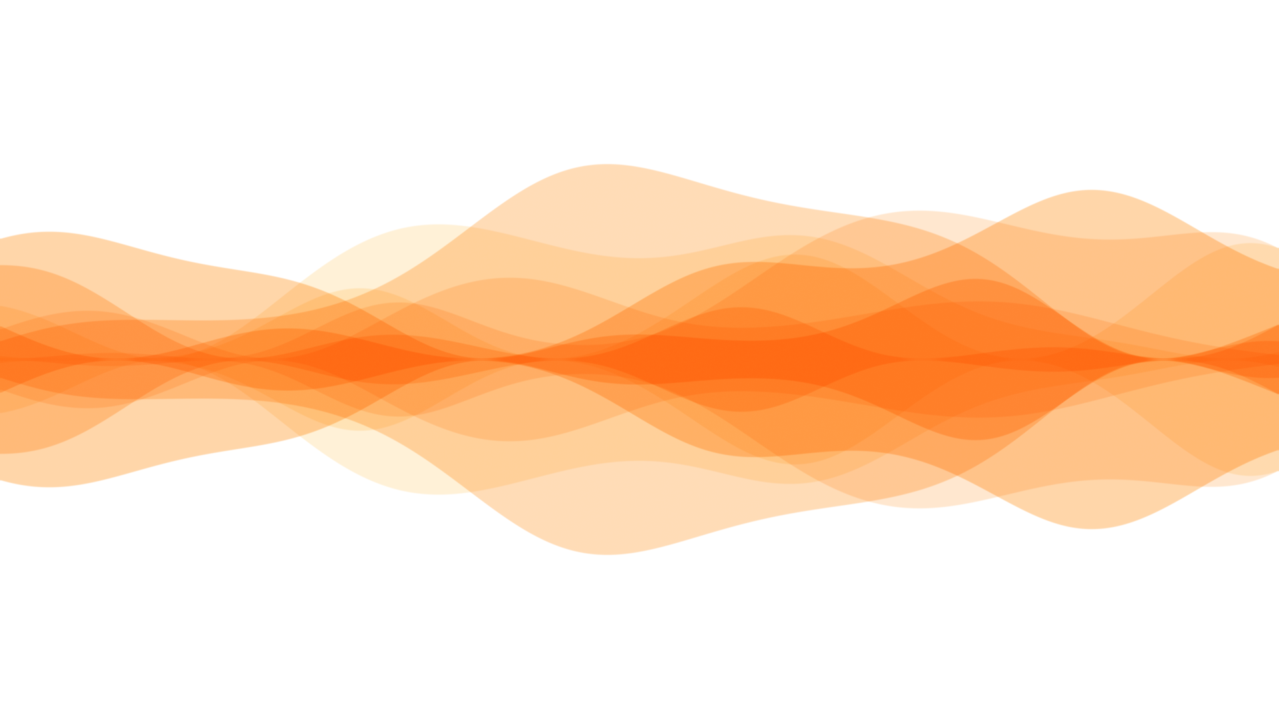
American Sign Language
Giving voice to sign language

Slide 2
Artifical Intelligence in Sign Language
1.5 billion people (~20% of the global population) have hearing loss or are deaf.
70 million people use Sign Language as their first language (less than 1% of the global population).
300 unique Sign languages Globally

Slide 3
1.437 Billion
Do not have have language to communicate

Slide 4
Artifical Intelligence in Sign Language
AI can bring uniformity globally in Sign Language
Bridge communication Gap between 1.5 billion people

Slide 5
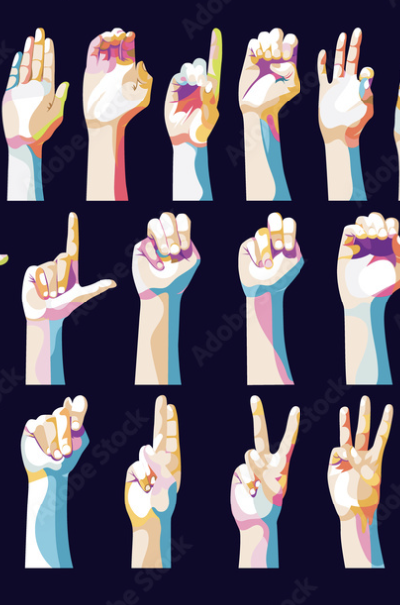
American Sign Language
About The Data
The Idea
Data Transformation
Model Building
Model Evaluation
Live Demo
Conclusion

Slide 6
DATASET
The dataset contains 27000 images(512 X 512) of alphabet signed in American Sign Language.
26 + 1 Class for each alphabet and 1 blank
Each class comprises of atleast 300-400 images

Slide 7




Slide 8
THE IDEA
Text Output
Image Classification
Capture Input
Process Image
LLM
Translated Output
Sentiment Analysis
GTTS
Notes:
### Speaker Notes:
The primary concept revolves around **capturing live video streams** from a mobile device to generate a **sentiment-based output**. This approach acknowledges that even the **same sign**, when expressed with different sentiments, can convey **entirely different meanings**.
To enhance this system, incorporating **Large Language Models (LLMs)** to assist in sentence formation. With the LLM's capability, the model eliminates the need to perform gestures for every single word, such as **prepositions** or **adjectives**, which can be inferred contextually. This results in a more fluid and efficient translation process.
Additionally, as the system processes more data from a specific user, it becomes increasingly **personalized** over time. This means the model learns the user’s **unique signing style**, preferences, and context, further improving its accuracy and relevance. Ultimately, this approach aims to provide a seamless and intelligent solution for real-time Sign Language communication, blending gesture recognition with advanced language understanding.

Slide 9
Challenges
To classify ASL into 27 classes , with a machine learning model, requires more than a dataset and convolution blocks
Reduction of Dataset size for faster processing and training
Reduction of Dataset to 17 classes for optimal implementation
Notes:
We had to reduce the number of classes and the dataset size because, based on our initial research, even the best-performing models required a lot of resources to train and use. These setups were expensive and not practical for our goals, so simplifying the model became necessary.

Slide 10
Data Transformation
Raw Image
(512x512)
NoBg Data
Resize
(256x256)
Grayscale
Image
Noise Removal
Processed Image
Notes:
Once the image is processed, we perform **data augmentation** to increase the dataset size. We use simpler techniques like **flipping**, **rotating**, **shearing**, and **adding noise** to create more variations of the data and improve the model's performance.

Slide 11
Why Background Removal
Eliminate irrelevant learning that could confuse the Model
Model training focused on gestures only
Lower training time.
Reduced Data size

Slide 12
80%
Size Reduction

Slide 13
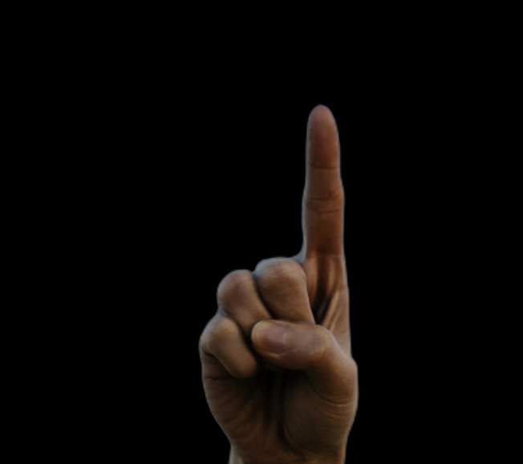
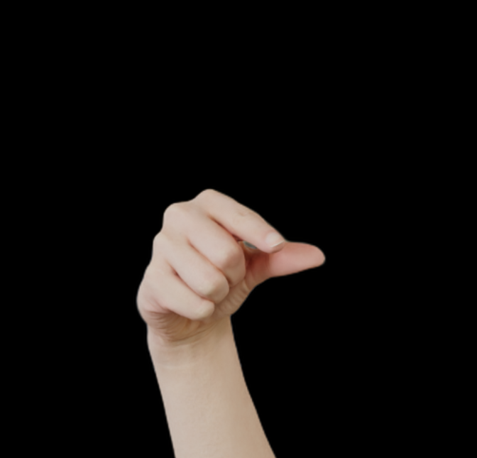


Slide 14
Model Building
3.7 Million Parameters
134 Million Parameters
Multiple CNN based Model at different Epochs implemented
424 K Parameters

Slide 15
Model Building
The main model consists of 3 CNN Layers (3*3) with 32, 64, 128 filters
Followed by a maxpooling (2*2)
Flattening Layer (1 D Vector)
2 Dense layer 1024 Neuron , 256 Neuron folowed by droupout rate of 50%
Relu Activation Implemented
Output classified using Softmax Activation Function
The model is trained using the Adam optimizer with a learning rate of 0.001, and the loss function used is CrossEntropyLoss for multi-class classification.

Slide 16
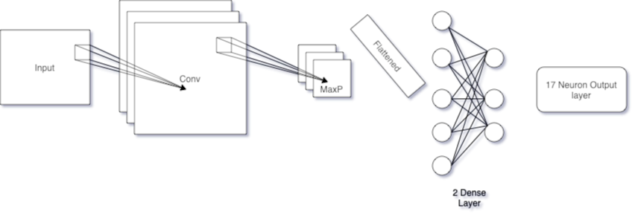
Model Building

Slide 17
Model Performance
Model | Epochs | Training Accuracy | Test Accuracy | Validation Accuracy
CNN-424 | 10 | 96% | 22% | 18%
CNN -3M | 35 | 75.1% | 93.72% | 89%
CNN -134M | 20 | 97.2% | 97.1% | 98%

Slide 18
97.1%
Test Accuracy

Slide 19
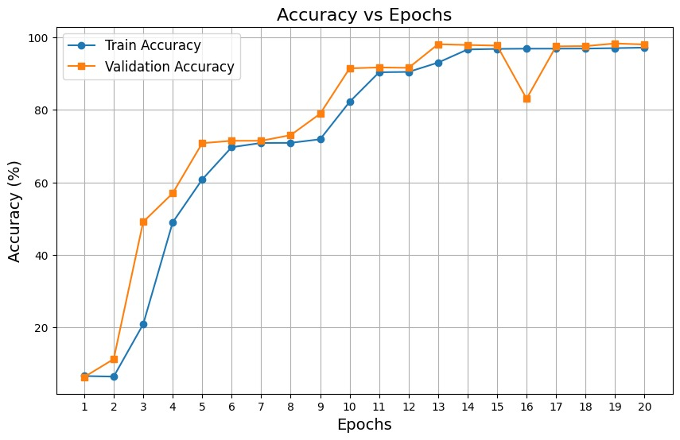

Slide 20
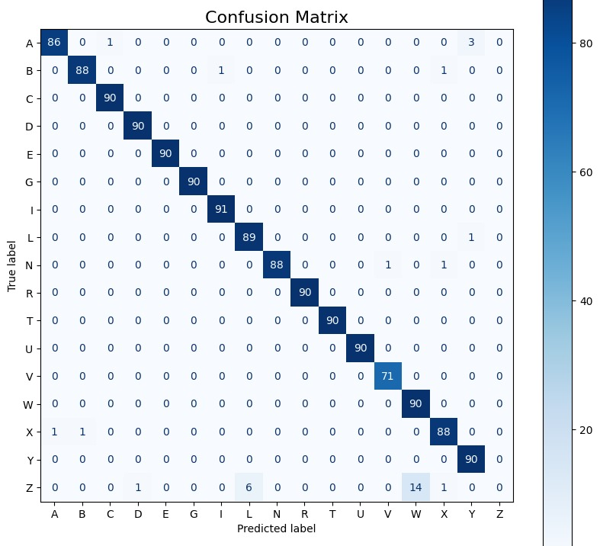

Slide 21
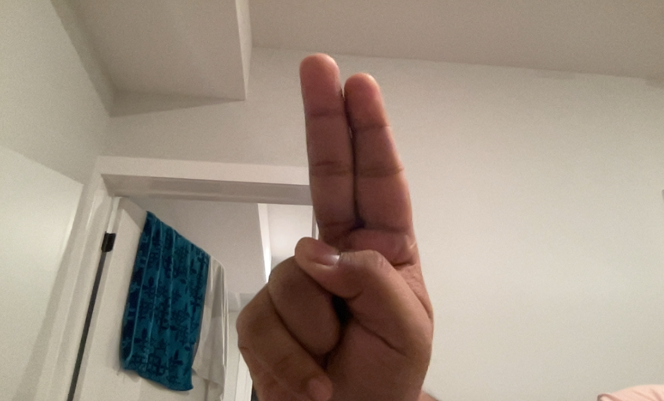
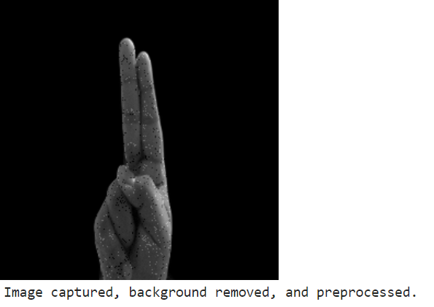
Implementation
Captured an image using the camera and ensured that the pre-processing steps were correctly applied.

Slide 22
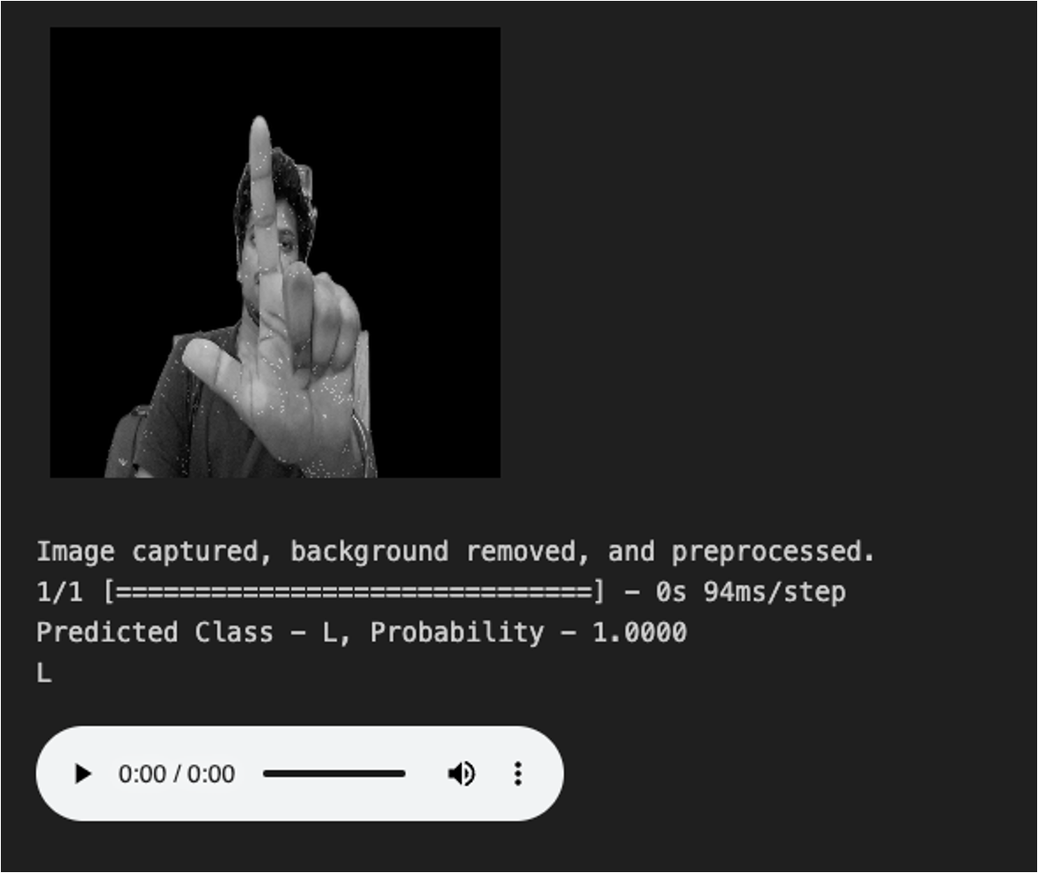
Implementation

Slide 23
Future advancemnets
Moving to Words from alphabets
Trained LSTM Model
Utilised Microsoft WASL 10000 class Dataset
Test Accuracy Achieved Merely 8%
Major Setbacks were limited resource and dataset to be limited to 2- 5 samples per class.

Slide 24
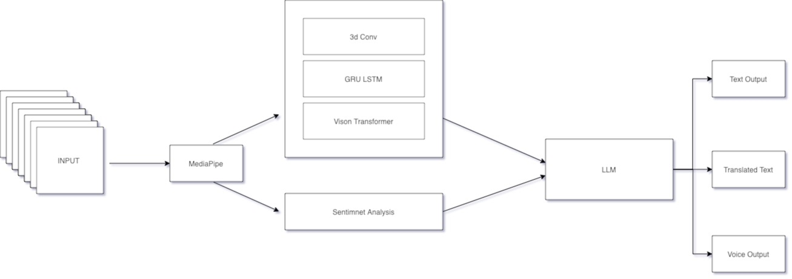
Future advancemnets

Slide 25
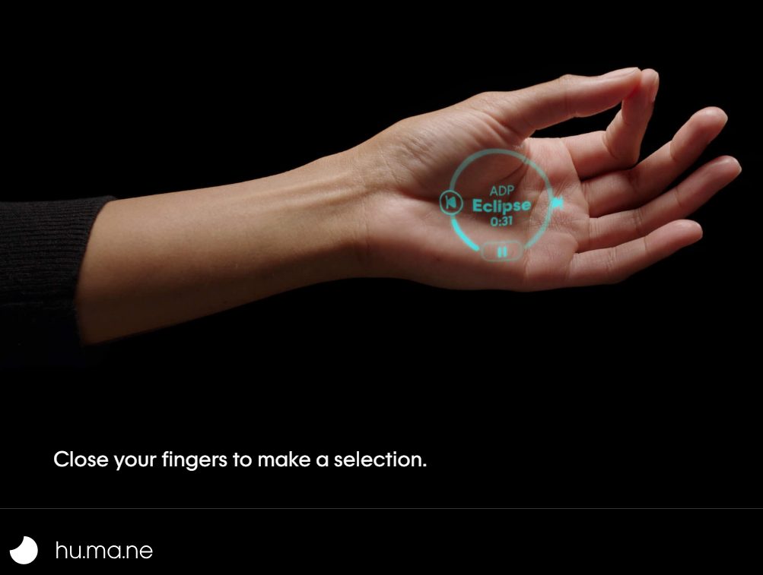
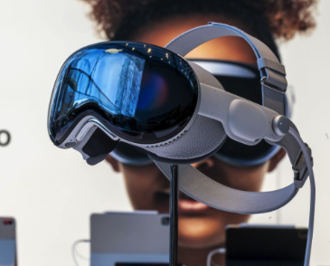
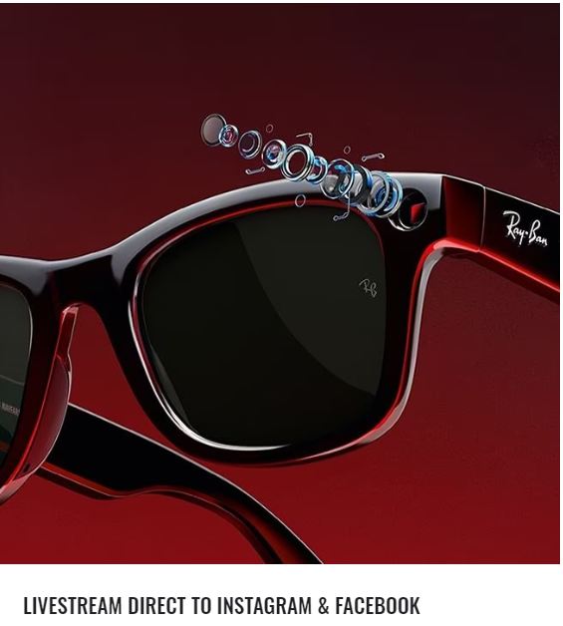
Applications
The Aim to give voice to signs language
Given the current technology, a dedicated device might not be necessary.
RAY-BAN META Smart Glasses , Humane Pin, Apple Vision Pro

Slide 26
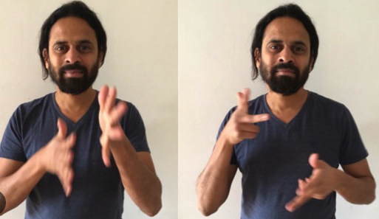
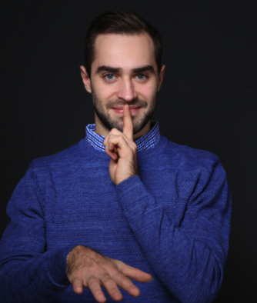
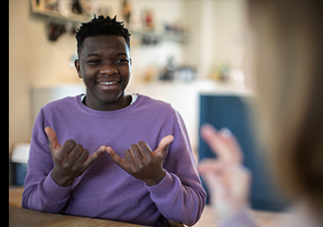
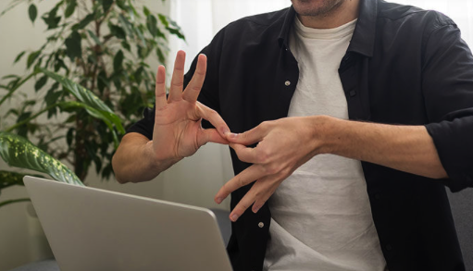

AI is a tool to solve the problem that limits Society

Slide 27
Thank You
Q&A
Aditya, Jais,Bhargavi

